Slide 1
빅데이터 시스템의 SSD 적용 효과 A Case study on Flash-Friendly File System (F2FS)
컴퓨터 시스템 연구회 ‘13 동계 워크샵
January 28, 2013
Jaegeuk Kim
S/W Development Team
Memory Division, Samsung Electronics Co., Ltd.

Slide 2
Agenda
Hadoop for Big Data
Application View
System View
Storage View
Flash-Friendly File System (F2FS)
Design of F2FS
Performance Evaluation
Summary

Slide 3
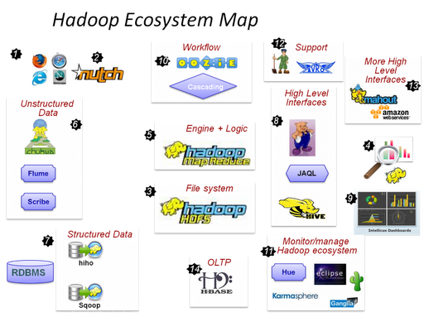
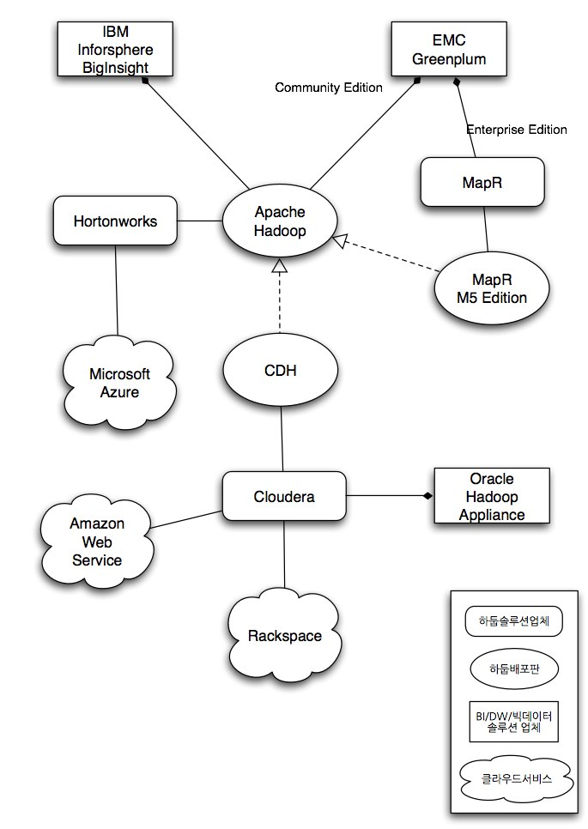
Hadoop for Big Data – Application View
출처: www.bicdata.com
Notes:
nutch 검색엔진 개발을 위해 hadoop platform이 개발됨
Hadoop은 분산 파일 시스템인 hdfs와 분산 처리 시스템인 map/reduce로 구성됨
단순히 여기서 그치지 않고, 꾸준히 확장하여, eco system을 구축함
비정형 데이터를 hadoop system에 저장하고 indexing하는 tool
기존 RDBMS의 정형 데이터를 연동시키는 tool
Hadoop platform의 workflow scheduler인 oozie를 개발
Hadoop 기반의 DB system인 Hbase, 그 외 monitoring 및 관리 tool과 여러 수준의 interface를 제공하여 쉽게 hadoop 시스템을 확장할 수 있음.
Eco system을 통합하는 작업 -> 세 회사에서 하여, distribution 하고 있음. (Cloudera’s Distribution, including Apache Hadoop)

Slide 4
Hadoop for Big Data – System View
DB
Analysis
Monitoring
Integration
Middleware (Hadoop HDFS/MapReduce)
Easy deployment
Guest OS
Guest OS
Guest OS
Memory
Management
Memory
Management
Memory
Management
Virtualization
File System
File System
File System
Server consolidation
Hypervisor (HVM, PVHVM, …)
HW resource
CPU/RAM
Network
Storage
(HDD, SSD, etc)
Notes:
이러한 hadoop platform의 기본적인 사상은 수천/수만대의 저사양 pc들로 최대한 parallel하게 주어진 일을 처리하는 것이 특징입니다.
하지만, 실제적으로 이러한 대규모 cluster system을 구축하기 위해서는 막대한 공간과 파워 소모, 그리고 관리 overhead가 필요하게 됩니다.
따라서, 이러한 문제를 해결하기 위하여, 가상화 기술을 적용하는 것입니다.
즉, 수많은 hadoop node들을 손쉽게 deploy하면서, 그에 따른 HW resource를 최대한 활용할 수 있는 server consolidation을 가능하게 하는 것이 가상화 기술의 핵심입니다.
좀 더 자세히 살펴 보면, hadoop platform인 hdfs와 map/reduce는 middleware로 구성되고, 그 위에…tool들이 존재
Hadoop을 구성하는 각각의 노드들은 guest vm으로 구성되고, hypervisor는 hw를 가상화하여 guest vm에게 service하는 역할을 하게 됩니다.
시스템 성능에서 생각을 해 보면, 성능은 storage의 성능에 가장 민감하다고 볼 수 있습니다.
왜냐하면, big data를 위한 hadoop system은 결국 데이터를 저장하고, 빠르게 읽어 원하는 데이터를 찾아내는 것이 되고, 찾기 위한 중간 결과물 역시 IO가 필요하기 때문입니다.

Slide 5

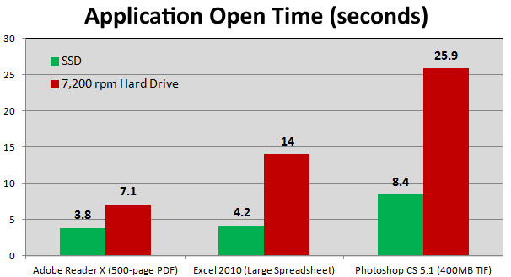
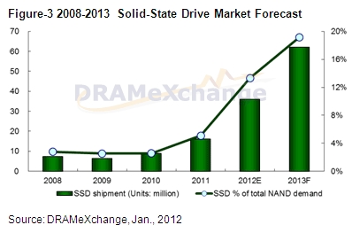
Hadoop for Big Data – Storage View
NAND Flash-based Storage Devices
SSD for PC and server systems
eMMC for mobile systems
SD card for consumer electronics
The Rise of SSDs
Much faster than HDDs
Low power consumption
Source: March 30th, 2012 by Avram Piltch, LAPTOP Online Editorial Director

Slide 6
Hadoop for Big Data – Vertical Optimization
DB
Analysis
Monitoring
Integration
Hadoop:
- HDFS chunk size
- # of task slots
- VM size
Middleware (Hadoop HDFS/MapReduce)
Guest OS
Guest OS
Guest OS
Guest OS
- # of guest OSes
- CPU clock
- Memory size
- Storage I/F
- File system
- IO scheduler
Memory
Management
Memory
Management
Memory
Management
File System
File System
File System
Hypervisor (HVM, PVHVM, …)
kvm, xen, …
- Para-virtualization
- Cache policy
- IO scheduler
CPU/RAM
Network
Storage
(HDD, SSD, etc)
SSD:
- FTL
- Wear-leveling

Slide 7
Flash-Friendly File System (F2FS)
Based on Log-structured File System (LFS)^{[1]}
Assume the whole disk space as a big contiguous area
Write all the data sequentially
Recover quickly with “checkpoint”
[Traditional File System]
[LFS]
Logical
Block
Address
Metadata Area
User-data Area
+ Metadata Area
4
8
User Data Area
8
7
3
6
5
7
4
3
6
2
Metadata Area
1
2
1
5
Time
Time
[1] Mendel Rosenblum and John K. Ousterhout. 1992. The design and implementation of a log-structured file system. ACM Trans. Comput. Syst. 10, 1 (February 1992), 26-52.

Slide 8
Flash-Friendly File System (F2FS)
Flash Awareness
Enlarge the random write area for performance, but provide the high spatial locality
Align FS data structures to the operational units in FTL
Wandering tree problem
Use a term, “node”, that represents inodes as well as various pointer blocks
Introduce Node Address Table (NAT) containing the locations of all the “node” blocks
Cleaning overhead
Support a background cleaning process
Support greedy and cost-benefit algorithms for victim selection policies
Support multi-head logs for static hot and cold data separation
Introduce adaptive logging for efficient block allocation

Slide 9
Design of F2FS (On-disk Layout)
Flash Awareness
All the FS metadata are located together for locality
Start address of main area is aligned to the zone size
Cleaning operation is done in a unit of section
Cleaning overhead
Six active logs for static hot and cold data separation
Random writes
Sequential writes
Zone
Zone
Zone
Zone
Section
Section
Section
Section
Section
Section
Section
Section
Segment Number
(1 segment = 2MB)
0
1
2
…
Superblock 0
Checkpoint Area
Segment Info.
Table
(SIT)
Node
Address
Table
(NAT)
Segment Summary
Area
(SSA)
Main Area
Superblock 1
2 segments
Per 2044GB of main area
0.4% over main area
0.2% over main area
Hot/Warm/Cold node segments
Hot/Warm/Cold
data segments

Slide 10
Design of F2FS (Index Structure)
Fixed location w/ locality
Multiple logs
SB
CP
NAT
Dir Inode
Directory data
File Inode
File data
…
File data
Segment Info. Table (SIT)
Indirect
Node
Segment Summary
(SSA)
Direct
Node
Used for cleaning
Direct node blocks for dir
Direct node blocks for file
Indirect node blocks
Dir data
File data
Cleaning data

Slide 11
Design of F2FS (Cleaning Process)
Background cleaning process
A kernel thread doing the cleaning job periodically at idle time
Victim selection policies
Greedy algorithm for foreground cleaning job
Cost-benefit algorithm for background cleaning job
Block allocation policy
Threaded logging
Reuse obsolete blocks without cleaning operations
Cause random writes
Copy-and-compaction
Need cleaning operations with some latency
Cause no random writes
Adaptive logging
Normally, copy-and-compaction is adopted
If there is not enough free space, the policy is dynamically changed to threaded logging

Slide 12
Performance Evaluation
System Environment
KVM
Intel i5 2400 3.1GHz
4GB DRAM
SATA2 512GB SSD
Kernel 3.8 rc3
Guest OS
Kernel 3.8 rc3
Test Scenario
IOzone 4GB sequential read/write
1GB random read/write
DB
Analysis
Monitoring
Integration
Middleware (Hadoop HDFS/MapReduce)
Guest OS
Guest OS
Guest OS
Memory
Management
Memory
Management
Memory
Management
File System
(EXT4 vs. F2FS)
File System
(EXT4 vs. F2FS)
File System
(EXT4 vs. F2FS)
Hypervisor (KVM : PVHVM)
CPU/RAM
Network
Storage
(SSD)
Notes:
32GB raw device로 guest VM 생성 + 8GB raw partition 하나씩 연결하여 테스트
메모리 4GB 에서 guest VM에 512MB 씩 할당
Cache none
virtIO interface 로 para-virtualization
모두 deadline scheduler

Slide 13
Summary
F2FS in Linux Kernel Mainline
Release to LKML (’12/10)
Merged into the linux-next tree (’12/11)
Merged into 3.8 rc-1 (’12/12)
3.8 정식 release 예정 (’13/02)
Download
Source: git://git.kernel.org/pub/scm/linux/kernel/git/jaegeuk/f2fs.git
Tools: git://git.kernel.org/pub/scm/linux/kernel/git/jaegeuk/f2fs-tools.git
Future work
Guest VM 에서의 F2FS 성능 분석 및 최적화
Hadoop parameter에 따른 성능 분석 및 평가

Slide 14
Thank you!

Slide 15
Log-structured File System (Index Structure)
Fixed location, but separated
One big log
SB
CP
Inode
Map
Dir Inode
Directory data
File Inode
File data
…
File data
Segment Usage
Used for cleaning
Segment Summary
Indirect
Pointer block
Direct
Pointer block

Slide 16
Design Issues I
Wandering tree problem ^{[2]}
Propagates index updates recursively
Goal
Eliminate or relax the update propagation
SB
CP
Inode
Map
Inode
Directory data
Inode
…
File data
File data
Indirect
Pointer block
Direct
Pointer block
[2] BITYUTSKIY, A. 2005. JFFS3 design issues. http://www.linux-mtd.infradead.org/.

Slide 17
Design Issues II
Cleaning Process
Reclaim obsolete data scattered across the whole storage for new empty log space
Get victim segments through referencing segment usage table
Load parent index structures of there-in data identified from segment summary blocks
Move valid data by checking their cross-reference
Goal
Hide cleaning latencies to users
Reduce the amount of valid data to be moved
Move data quickly
Specific Issues
Cleaning in the background
Victim selection policy
Hot and cold data separation
Instant valid data identification

Slide 18
Design of F2FS (On-disk Layout)
Flash Awareness
All the FS metadata are located together for locality
Start address of main area is aligned to the zone size
Cleaning operation is done in a unit of section
Cleaning overhead
Six active logs for static hot and cold data separation
Random writes
Sequential writes
Zone
Zone
Zone
Zone
Section
Section
Section
Section
Section
Section
Section
Section
Segment Number
(1 segment = 2MB)
0
1
2
…
Superblock 0
Checkpoint Area
Segment Info.
Table
(SIT)
Node
Address
Table
(NAT)
Segment Summary
Area
(SSA)
Main Area
Superblock 1
2 segments
Per 2044GB of main area
0.4% over main area
0.2% over main area
Hot/Warm/Cold node segments
Hot/Warm/Cold
data segments

Slide 19
Design of F2FS (Index Structure)
Fixed location w/ locality
Multiple logs
SB
CP
NAT
Dir Inode
Directory data
File Inode
File data
…
File data
Segment Info. Table (SIT)
Indirect
Node
Segment Summary
(SSA)
Direct
Node
Used for cleaning
Direct node blocks for dir
Direct node blocks for file
Indirect node blocks
Dir data
File data
Cleaning data

Slide 20
Design of F2FS (Cleaning Process)
Background cleaning process
A kernel thread doing the cleaning job periodically at idle time
Victim selection policies
Greedy algorithm for foreground cleaning job
Cost-benefit algorithm for background cleaning job
Block allocation policy
Threaded logging
Reuse obsolete blocks without cleaning operations
Cause random writes
Copy-and-compaction
Need cleaning operations with some latency
Cause no random writes
Adaptive logging
Normally, copy-and-compaction is adopted
If there is not enough free space, the policy is dynamically changed to threaded logging

Slide 21
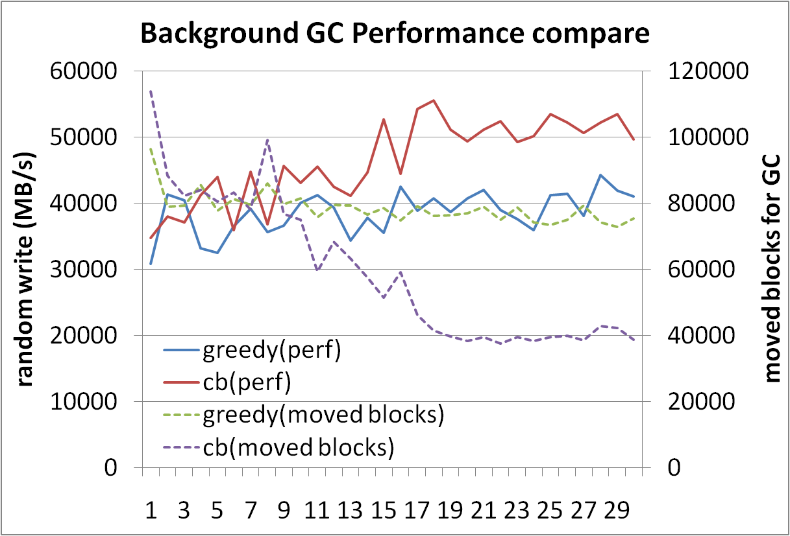
Cleaning Performance
Background cleaning process
A kernel thread doing the cleaning job periodically at idle time
Victim selection policies
Greedy algorithm for foreground cleaning job
Cost-benefit algorithm for background cleaning job

Slide 22
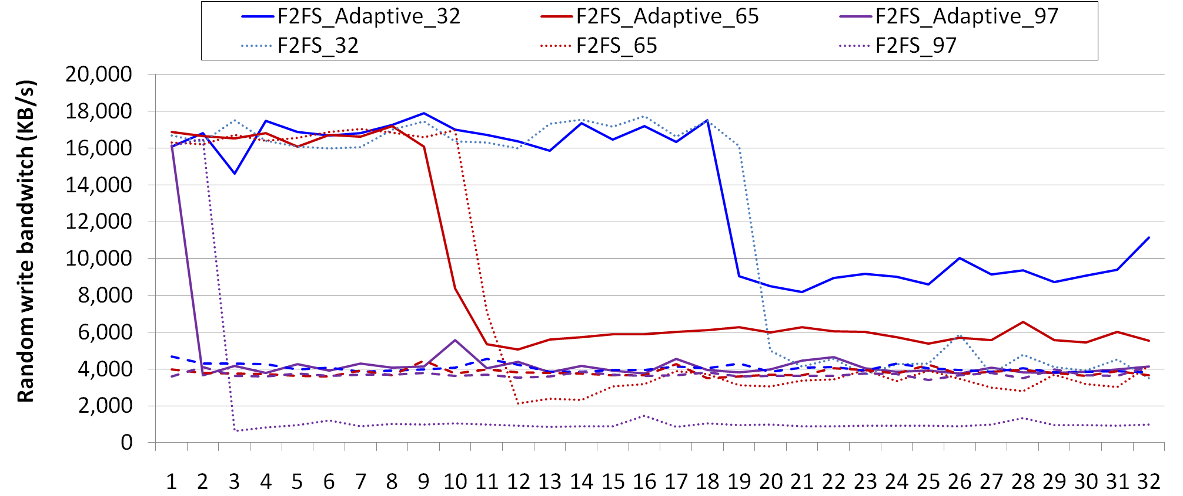
Adaptive Logging
Setup
Embedded system with eMMC 12GB partition
Iozone random write tests on Several 1GB files
ext4 shows about 4,000 KB/s continuously

Slide 23
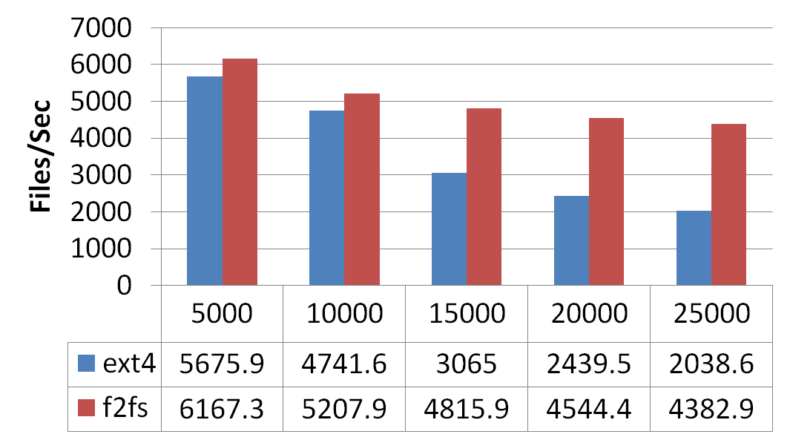
Performance Evaluation (micro benchmark)
[ System Specification ]
CPU | ARM Coretex-A9 1.2GHz
DRAM | 1GB
Storage | Samsung eMMC 64GB
Kernel | Linux 3.3
Partition Size | 12 GB
[ iozone ]
[ fs_mark ]
[ bonnie++ ]

Slide 24
Performance Evaluation (Galaxy S2)
Quadrant
 | ext4 | f2fs
I/O Performance | 3476 | 3724 | 248(7.13%)
RLBench
 | ext4 | f2fs
Overall(sec) | 40.76 (0.98) | 33.57 (2.01) | -7.18(17.62%)
1000 INSERTs(sec) | 20.59 (0.9) | 11.96 (1.82) | -8.63(41.93%)
25000 INSERTs in a transaction(sec) | 1.79 (0.08) | 1.71 (0.01) | -0.08(4.48%)
25000 INSERTs into an indexable table in a transaction(sec) | 1.79 (0.08) | 1.75 (0.03) | -0.03(1.9%)
100 SELECTs without an index(sec) | 0.08 (0.04) | 0.05 (0.02) | -0.03(34.21%)
100 SELECTs on a string comparison(sec) | 0.07 (0.02) | 0.15 (0.21) | 0.08(-108.33%)
Creating an index(sec) | 0.82 (0.04) | 0.94 (0.09) | 0.12(-14.08%)
5000 SELECTs with an index(sec) | 1.47 (0.11) | 1.54 (0.06) | 0.07(-4.75%)
1000 UPDATEs without an index(sec) | 4.48 (0.04) | 4.48 (0.12) | 0(0%)
25000 UPDATEs with an index(sec) | 3.99 (0.08) | 4.14 (0.18) | 0.15(-3.81%)
INSERTs from a SELECT(sec) | 1.62 (0.15) | 1.81 (0.27) | 0.19(-11.7%)
DELETE without an index(sec) | 1.47 (0.25) | 2.02 (0.43) | 0.55(-37.41%)
DELETE with an index(sec) | 1.43 (0.26) | 1.64 (0.3) | 0.21(-14.85%)
DROP TABLE(sec) | 1.16 (0.11) | 1.48 (0.2) | 0.31(-26.98%)
Reduce total execution time by 18% over ext4
Reduce DB insertion time by 42% over ext4
Improve random write performance by 94% over ext4
Androbench
 | ext4 | f2fs
Sequential Read(MB/s) | 41.58 (2.72) | 41.78 (2.05) | 0.2(0.48%)
Sequential Write(MB/s) | 4.81 (1.19) | 5.63 (1.15) | 0.82(17.05%)
Random Read(MB/s) | 3.39 (0.06) | 3.46 (0.07) | 0.07(2.12%)
Random Write(MB/s) | 0.25 (0.01) | 0.48 (0.01) | 0.23(93.5%)
SQLite Insert(s) | 15.05 (0.37) | 16.63 (0.39) | 1.58(-10.5%)
SQLite Update(s) | 6.28 (0.27) | 3.51 (0.31) | -2.77(44.16%)
SQLite Delete(s) | 6.49 (0.19) | 3.89 (0.56) | -2.59(39.96%)
Reduce DB update time by 44% over ext4

Slide 25
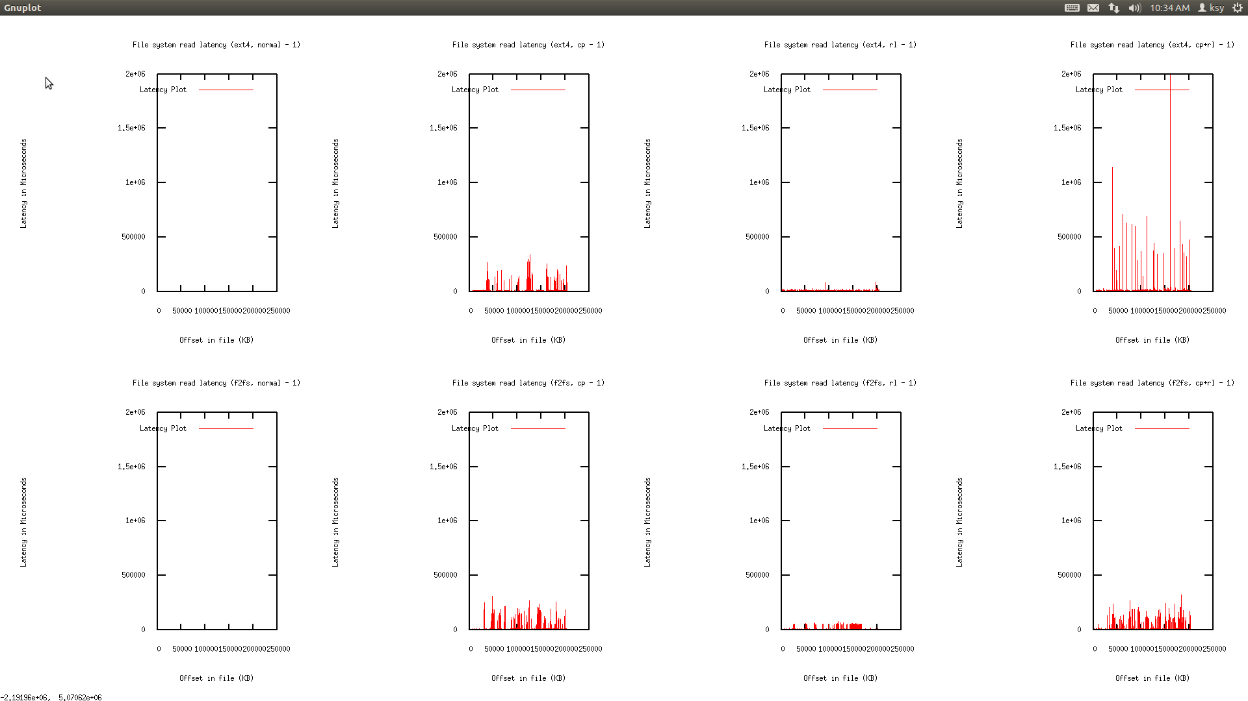
Performance Evaluation (Galaxy S2)
Multi-tasking Scenario
Run RLBench and file copying in background
Measure video streaming latencies in foreground
High latency may cause cracks in videos
Results
Ext4 shows a latency by up to 2.5s, and over 0.5s of latencies more than 10 times
F2FS shows a latency by up to 0.35s
microseconds
microseconds

Slide 26
Performance on Galaxy Nexus
CPU | ARM Coretex-A9 1.2GHz
DRAM | 1GB
Storage | Samsung eMMC (VFX) 16GB
Kernel | 3.0.8
Android ver. | Ice Cream Sandwich
< Clean >
< Aged >
Items |  | Ext4 | F2FS | Improv.
Contact sync time (seconds) |  | 431 | 358 | 20%
App install time (seconds) |  | 459 | 457 | 0%
RLBench (seconds) |  | 92.6 | 78.9 | 17%
IOZoneWith AppInstall (MB/s) | Write | 8.9 | 9.9 | 11%
 | Read | 18.1 | 18.4 | 2%
Items |  | Ext4 | F2FS | Improv.
Contact sync time (seconds) |  | 437 | 375 | 17%
App install time (seconds) |  | 362 | 370 | -2%
RLBench (seconds) |  | 99.4 | 85.1 | 17%
IOZone With AppInstall (MB/s) | Write | 7.3 | 7.8 | 7%
 | Read | 16.2 | 18.1 | 12%

Slide 27
Summary
Flash-Friendly File System
Focused on Performance and Reliability
Not, on new fancy functionalities
Ubuntu 12.04 LTS
Format “/” as F2FS
Install & compile kernel & run several applications
Galaxy S2, S3, and Nexus
Format “/data” as F2FS
Factory reset & run android apps
Further Optimization
Together!

